Slide 1

House Design approach

Slide 2
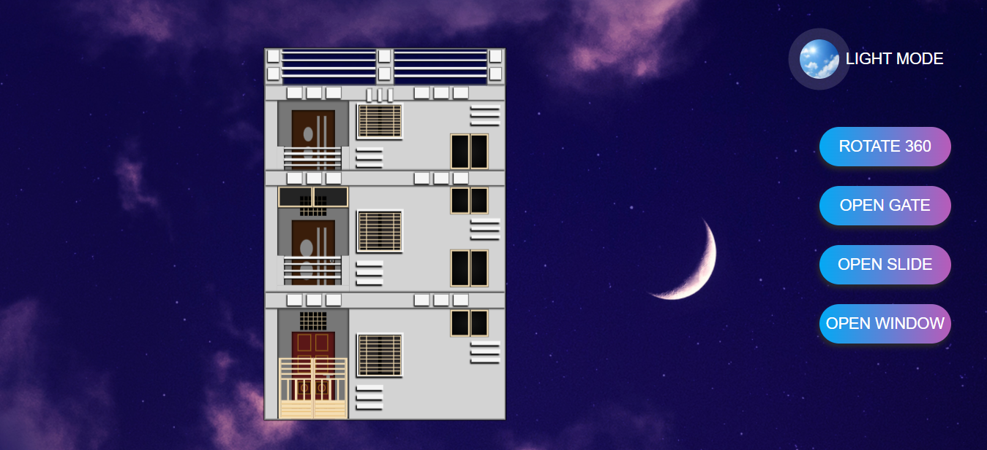
.house-Wrapper :- display : flex;
.house{
flex-basis : 80%
}
.menu{
flex-basis : 20%
}

Slide 3
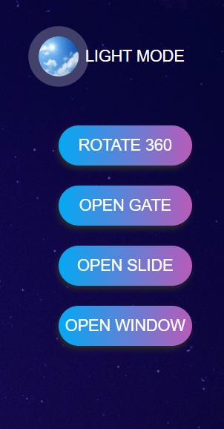
.house-wrapper .menu :-
.toggle{
position: absolute;
top: 2%;
right: 15%;
z-index: 1;
}
.toggle is absolute to full screen.
.menu {
display: flex;
flex-direction: col;
align-items: center;
justify:-content: center;
gap: 3rem;
padding-right: 1rem;
}

Slide 4
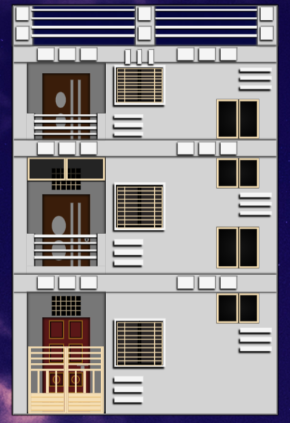
.front-view :- display: flex; flex-direction: Col;
.terrace{
flex-basis: 34%
}
.first-floor{
flex-basis: 33%
}
.front-view
.ground-floor{
flex-basis: 33%
}

Slide 5
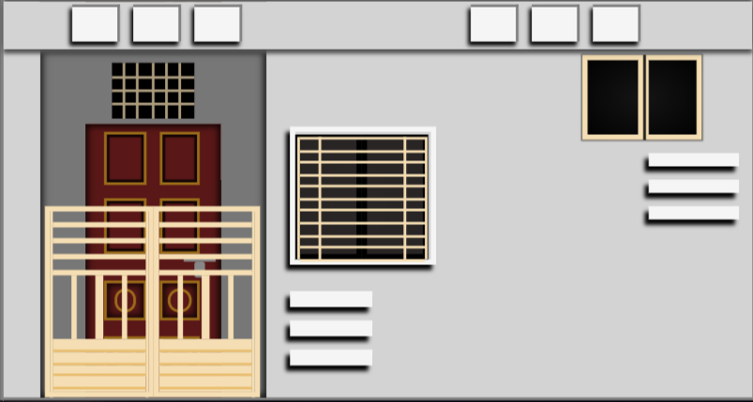
.ground-floor :- display: flex; flex-direction : col;
.header-view{
flex-basis: 12%
}
.main-view{
flex-basis: 88%
}

Slide 6
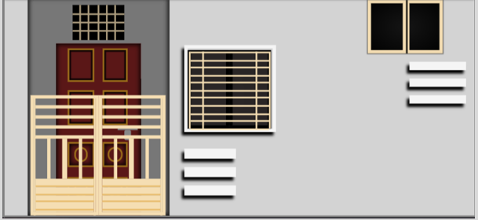
.ground-floor .main-view :- display : flex;
.left-part{
flex-basis : 30%
margin-left: auto;}
.right-part{
flex-basis : 65%
}

Slide 7
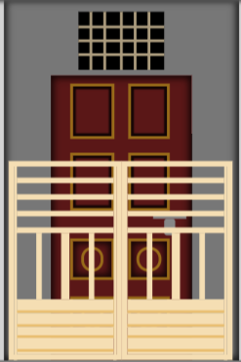
.main-view .left-part :- flex-direction :col;
.inside-window{
flex-basis: 18%;
}
.inside-door{
flex-basis: 68%;
}
.left-part {
display: flex;
flex-direction: col;
position: relative;
gap: 2rem;
}
.left-part .gate{
position: absolute;
z-index: 1;
top: 45%;
}

Slide 8
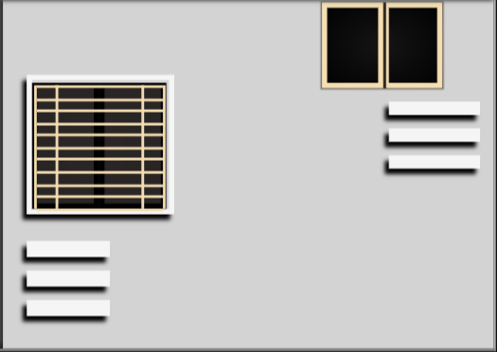
.main-view .right-part :- display : flex;
.slider-part{
flex-basis: 60%
Margin-left: auto;
}
.window-part{
flex-basis: 35%
}

Slide 9
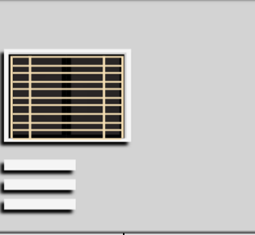
.ground-floor .slider-part :- flex-direction : col;
.slider-part {
display: flex;
flex-direction: col;
align-items: start;
gap: 2rem;
}
.slide-wrapper{
flex-basis: 40%;
margin-top: auto;
width: 50%
}
.three-bars{
flex-basis: 30%
width: 28%
}

Slide 10
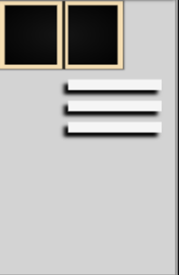
.ground-floor .window-part :- flex-direction : col;
.small-window{
flex-basis: 25%;
margin-top: .3rem;
width: 75% }
.three-bars{
flex-basis: 25%
width: 54%
align-self: flex-end;
margin-right: 1rem;
}
.window-part {
display: flex;
flex-direction: col;
align-items: start;
justify:-content: start;
gap: 1rem;
}

Slide 11
Similar approach followed to first-floor and terrace part

Slide 12
View source code for detailed implementation https://github.com/jayesh2906/my-house.github.io Thank You…

